Slide 1

HoldMyBook :
E-library Management System

Slide 2
Index
01
Group Members
04
Requirement Gathering
02
About Company
05
Tools And Technologies
03
Project Introduction
06
Data Flow Diagram
07
Data Dictionary
08
ER-Diagram

Slide 3
1. Group Members
Internal Guide
Jaison John – 20-BCA-053
Nikhil Motwani – 20-BCA-082
Hardik Vekariya – 20-BCA-177
Prof. Akash Pareek
External Guide
Brijesh Shukla

Slide 4
About Company
2
Let’s start with the second set of slides

Slide 5
Company Introduction
Company Name : OMFiNiTiVE - Website Development & Digital Marketing Company
Address : Gopal Tower, 312 Rajdeep Complex, Opp, Maninagar, Ahmedabad, Gujarat 380008
Company Owner Name : Brijesh Shukla
Phone No : +91 9979 45 7999
Email : info@omfinitive.com

Slide 6
Company Introduction
OMFiNiTiVE specializes in web development, website design, ecommerce development, web application, custom development, flash and SEO. its a company with ample amount of flexibility.
It is privately funded and it does not rely on venture capital and operates on a continuously profitable basis. Thus, is able to maintain all operations and growth with the current revenues.

Slide 7
Project Introduction
3
Let’s start with the third set of slides

Slide 8
HoldMyBook is a online library management system where the users using the system can use the system as a buyer as well as a seller. This system allows the bibliophiles to buy e-copy or the physical copy of the book.
Users can also borrow the physical copy of a book through our system and collect from the library. Sellers can keep the e-copies and physical copies of their books on the system for sale.
Sellers or the librarian can showcase their books through photos, videos and description of the book.

Slide 9
Requirement Gathering
4
Let’s start with the fourth set of slides

Slide 10
Entity
Admin, Seller, User And Visitor are involved in functional requirements
Super Admin
Librarian (Admin)
User (Buyer/Seller)
Visitor

Slide 11
Super Admin
Super Admin can login.
Super Admin can view user details.
Super Admin can delete users.
Super Admin can view books and book categories.
Super Admin can view and manage data related to current librarian.

Slide 12
Librarian (Admin)
Librarian can login.
Librarian can view user details.
Librarian can delete users.
Librarian can modify, add, delete and view book details.
Librarian can modify, add, delete and view book categories.
Librarian can accept orders.
Librarian can manage transactions related to selling and buying of books.

Slide 13
Users (Buyer/Seller)
Users can login.
Users can add, view, buy and delete books.
Users can borrow books.
Users can view book issue details.
Users can place, accept and delete orders.
Users can view cart details.
Users can manage payment transactions.

Slide 14
Visitor
Visitor can sign up on the system.
Visitor can view the currently available book data.

Slide 15
Existing System
- ebookselibrary.com is an online book portal which lets the users to read free e-books and also buy e-books from the portal
- The system has e-books divided on the basis of different subjects and genres.
- Books can also be filtered on the basis of professional courses on this system
- Various competitions are held related to subjects of competitive exams.
Books are also available in the collections of academic levels(Pre-primary to class 12).
Different kinds of journals are also available on this system.
- Users cannot buy physical books or can download e-books
with the use of this system.
Reference - www.ebookselibrary.com

Slide 16
Proposed System
HoldMyBook is an online library management system which lets the users to buy, borrow and sell e-copies or physical copies of books from the system.
Librarians also have the freedom to sell or lend books on this system.
The system has physical copies and e-copies of books divided on the basis of different subjects and genres.
Books can also be filtered on the basis of different genres on this system.
Statistics related to the book transactions will be available in the form of graphs and charts.

Slide 17
Continue…
Users can borrow physical books after paying some refundable deposit and borrow charges.
Superadmin can change and update the information related to the current librarian(Admin).
Additional features
- Librarians will get the access of analytics related to the books.
- Users can borrow physical books with the use of this system.
- Users can also buy physical books from the system.

Slide 18
Tools And Technology Used
5
Let’s start with the fifth set of slides

Slide 19



Frontend Technology
CSS3
[Cascading Style Sheets]
JS
[Vanilla java script]
HTML5
[Hypertext Markup Language]

Slide 20



Backend Technology
DJ[4.0]
[Django]
My SQL [ 8.0.5 ]
[My Structured Query Language]
Python[3.9]

Slide 21


Documentation and Design Tools
Design Tool
[Figma]
Draw.io

Slide 22
Data Flow Diagram
6
[ DFD ]

Slide 23
Context
Level
DFD

Slide 24
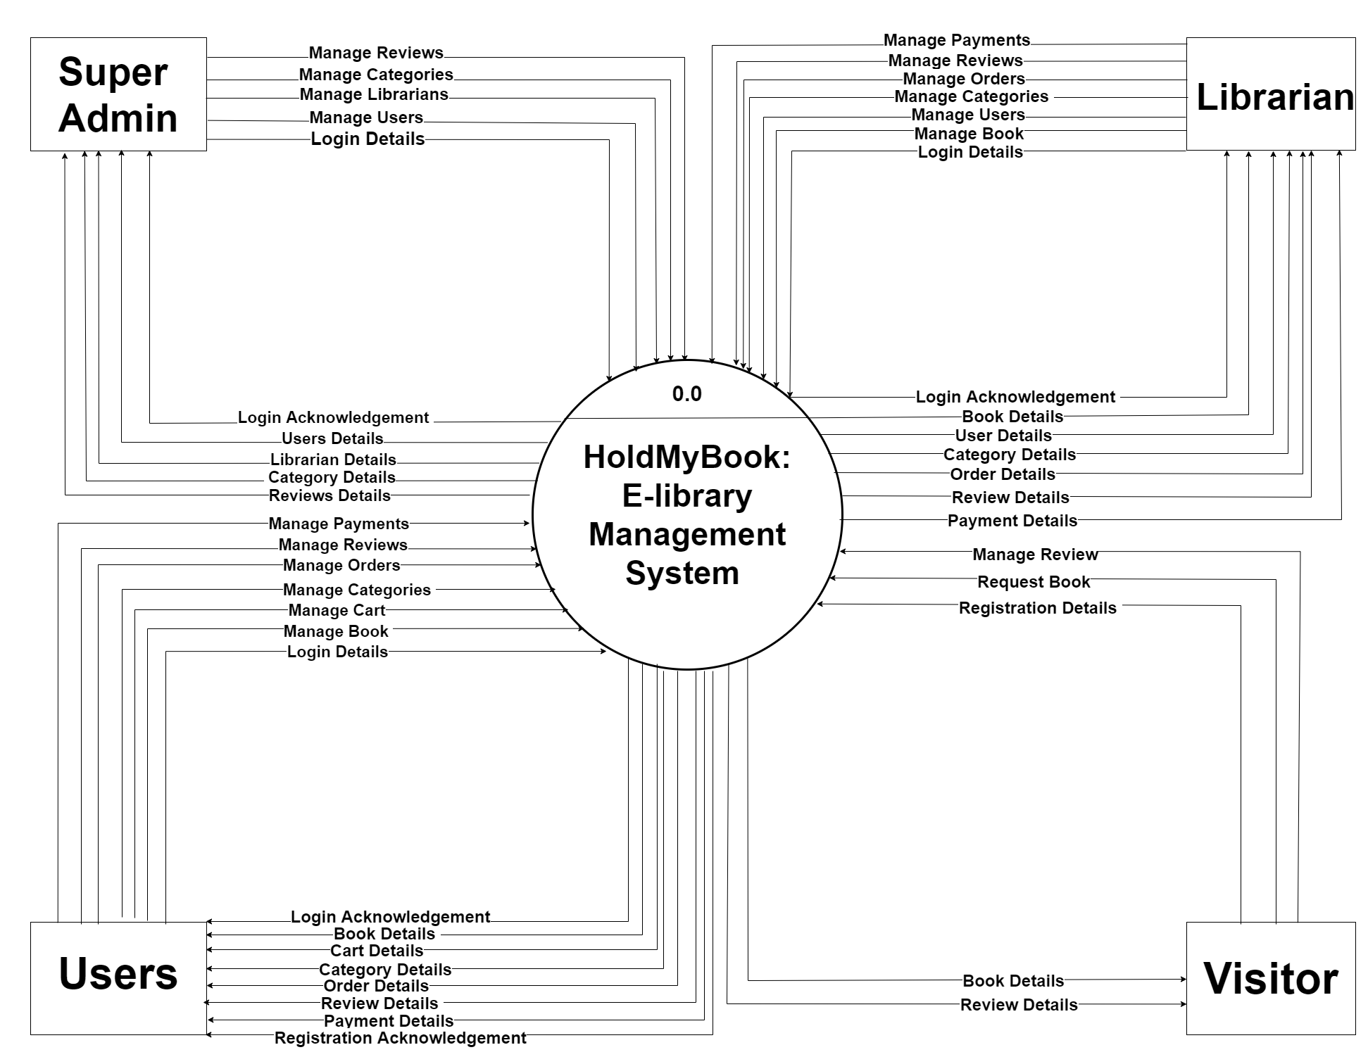

Slide 25
Level 1
DFD

Slide 26
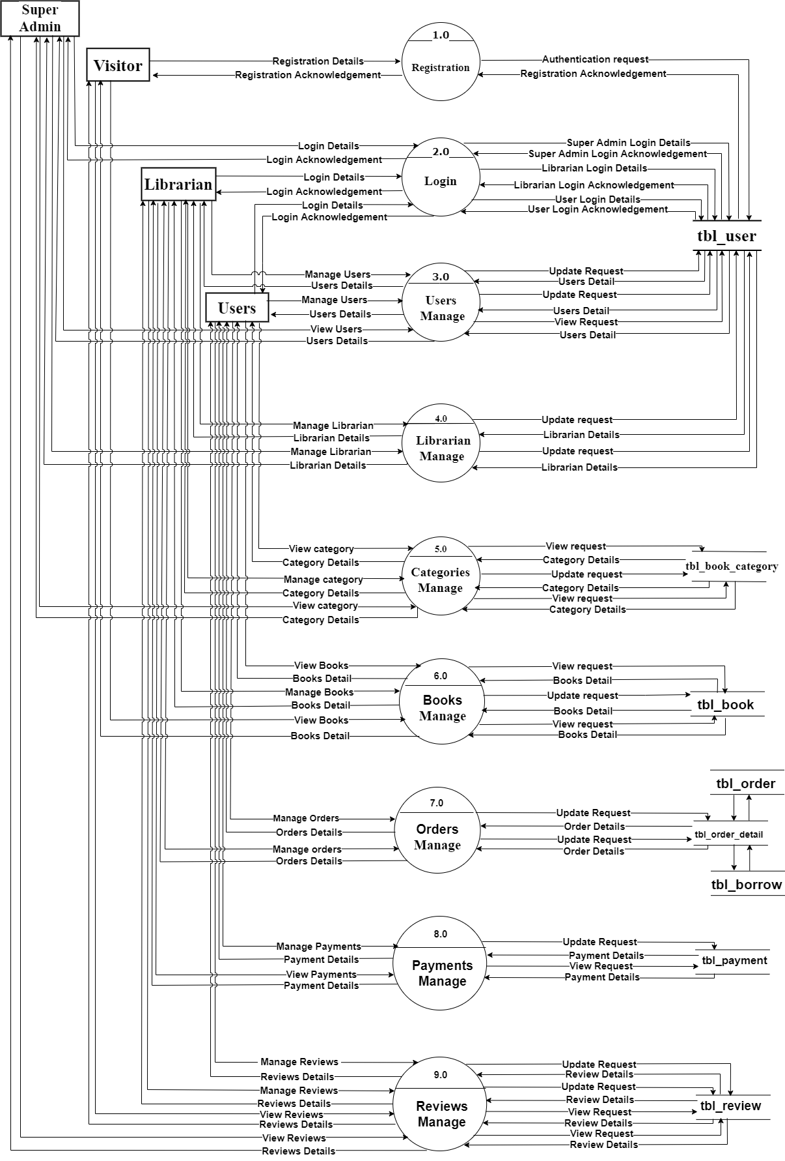

Slide 27
Level 2
DFD

Slide 28
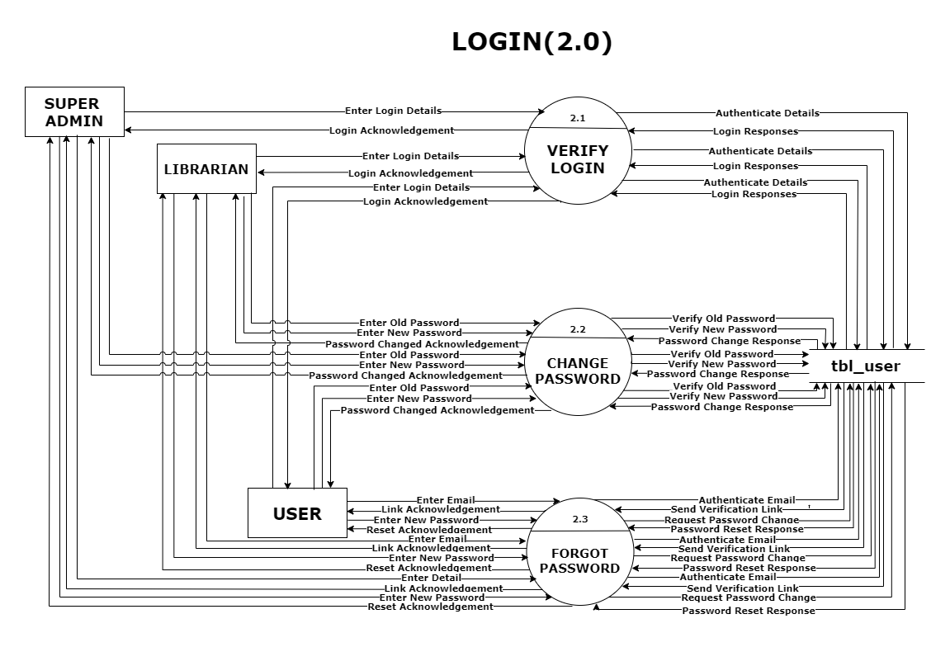

Slide 29
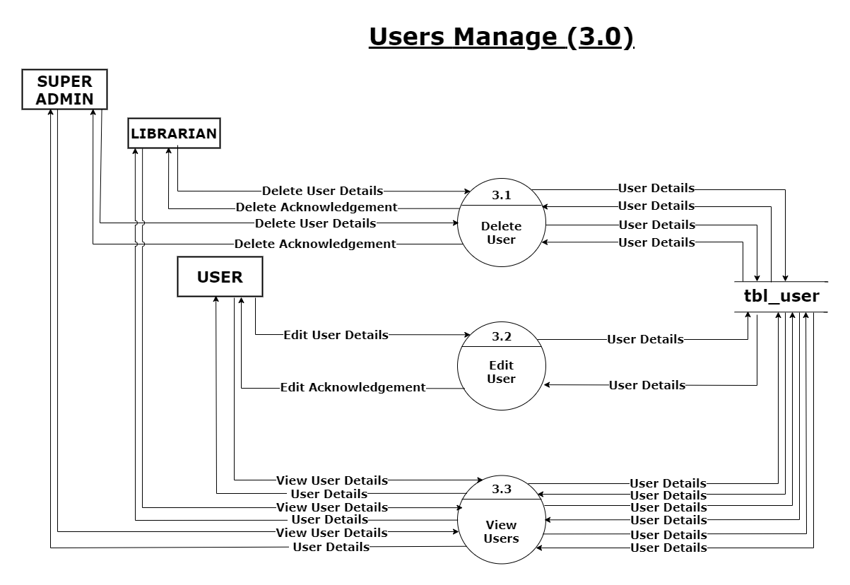

Slide 30
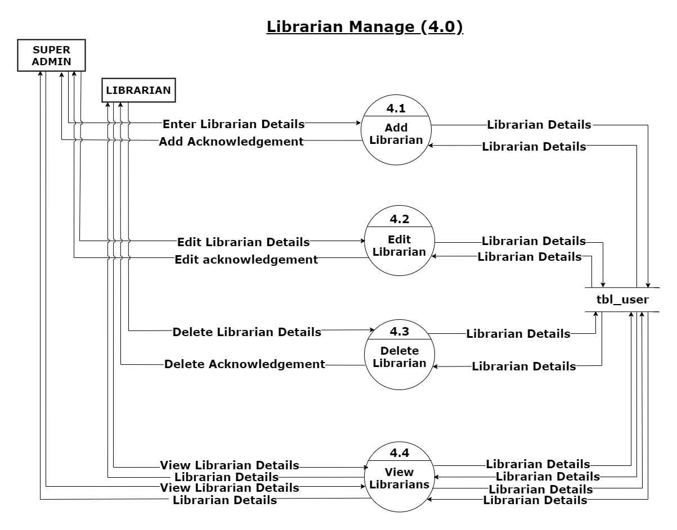

Slide 31
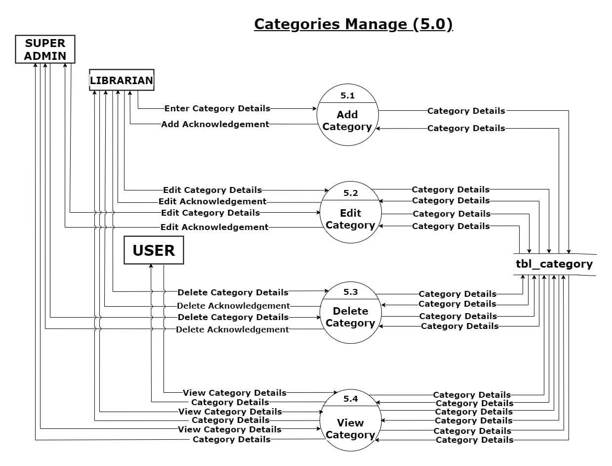

Slide 32
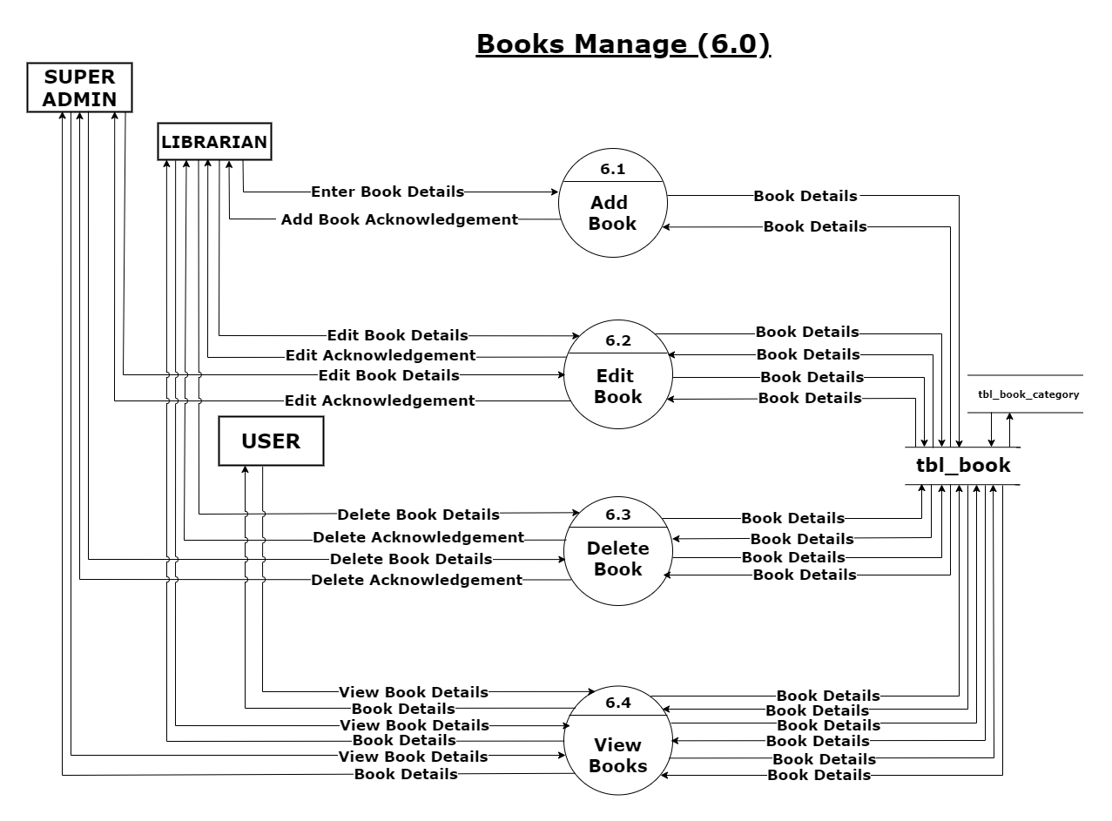

Slide 33
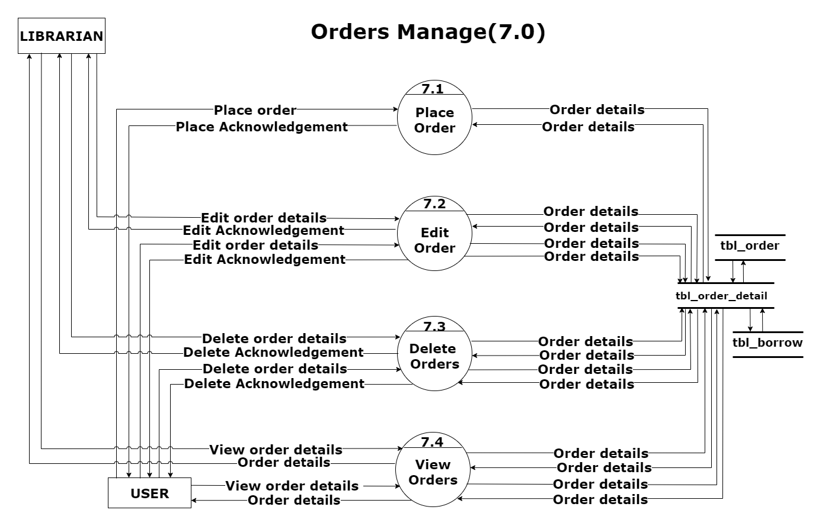

Slide 34
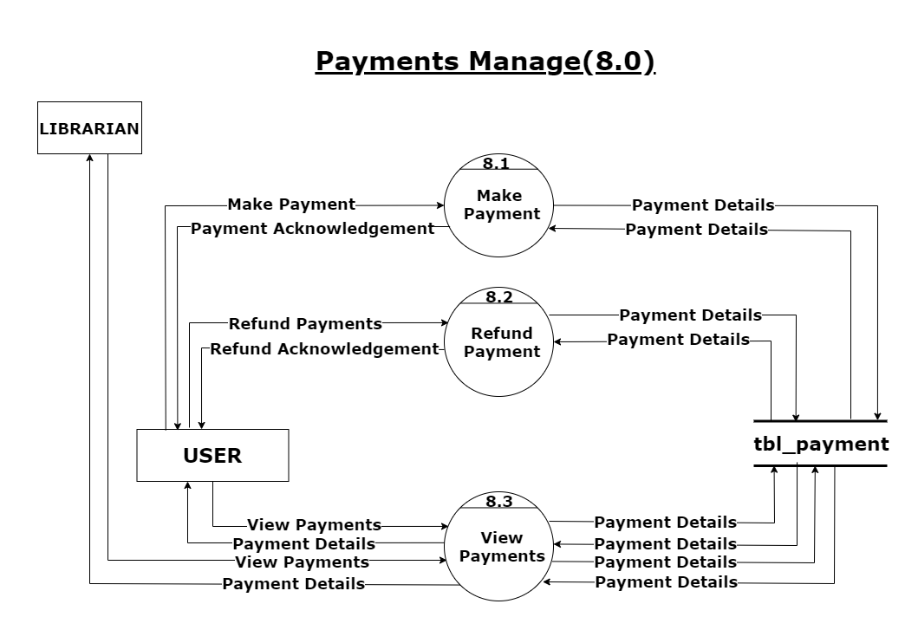

Slide 35
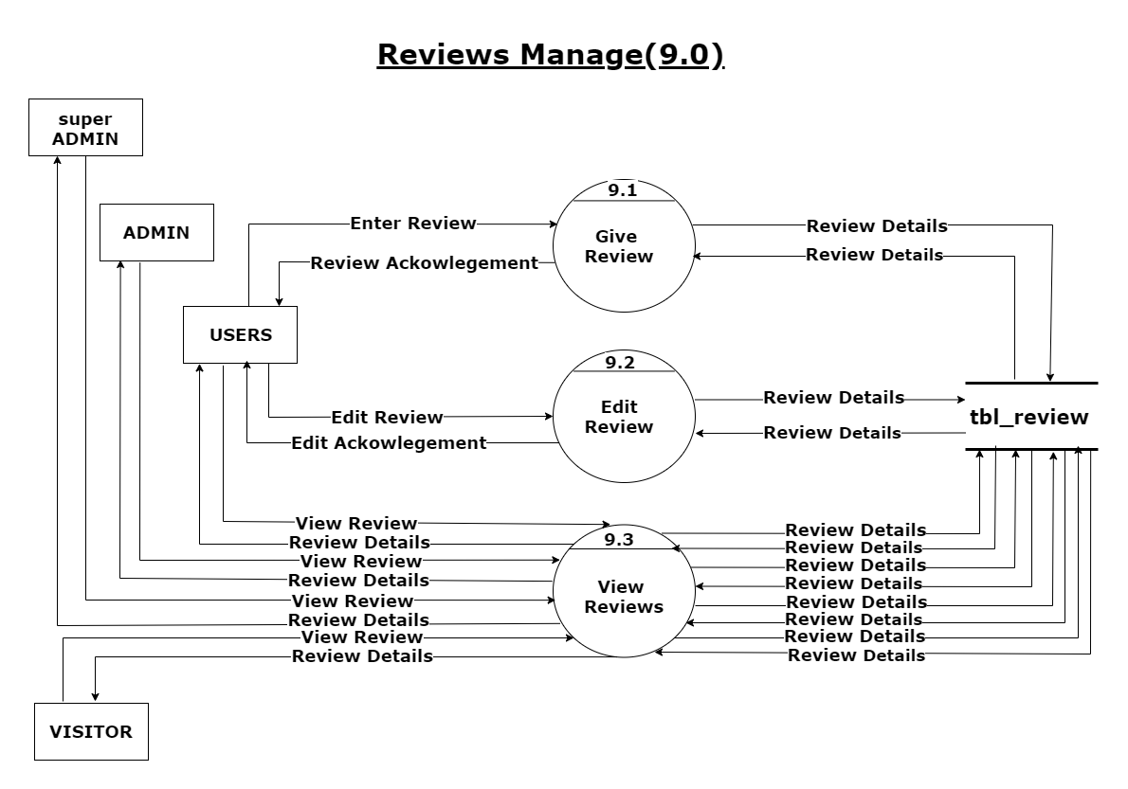

Slide 36
Data
Dictionary

Slide 37
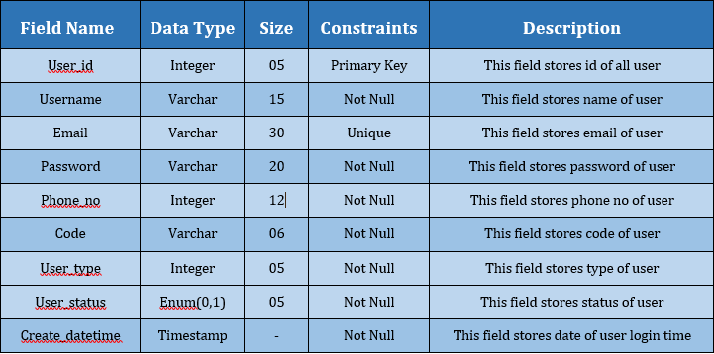
tbl_user
tbl_user is the table which stores all the details entered by the users who are registered on this system. The details in this table will get updated if any user edits his/her details.

Slide 38
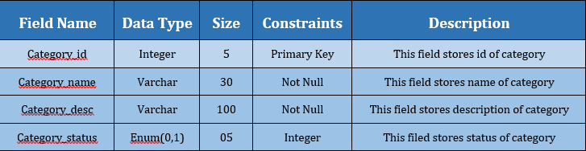
tbl_book_category
tbl_book_category is the table which stores all the details regarding the different categories of the books on the system. The details regarding categories in this table will get updated if any admin edits the categories.

Slide 39
tbl_book
tbl_book is the table which stores all the details regarding the different books on the system. The details regarding books in this table will get updated if any user edits the book data. Fields are created for inserting images and description in this table.

Slide 40
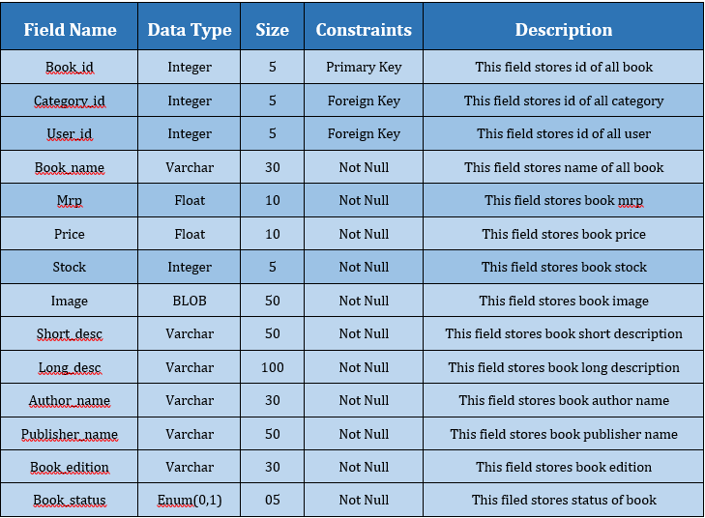

Slide 41
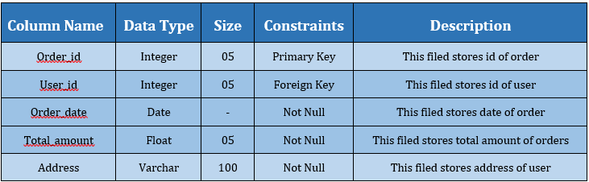
tbl_order
tbl_order is the table which stores all the details regarding the orders on the system. The details regarding orders in this table will get updated if any user edits, places or cancels orders. Fields are created for date and time of orders in this table.

Slide 42
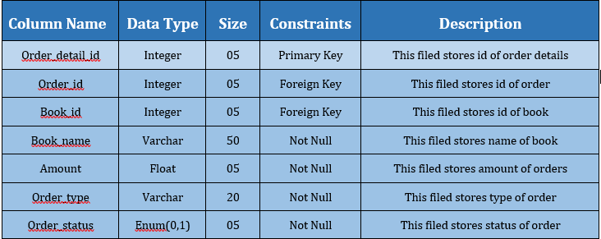
tbl_order_detail
tbl_order_detail is the table which stores all the details regarding the orders on the system. The details regarding orders in this table will get updated if any user edits, places or cancels orders. Fields are created for date and time of orders in this table.

Slide 43
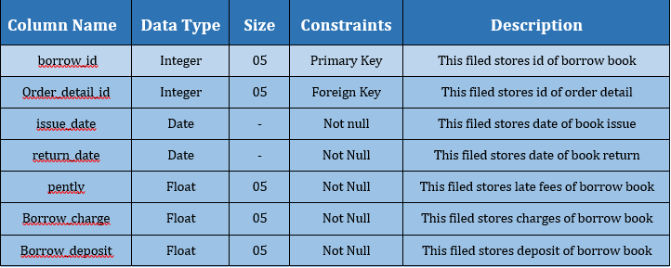
tbl_borrow
This table shows stores details of various borrow orders like borrow_id, issue_date, return_date, pently, borrow_charge etc.

Slide 44
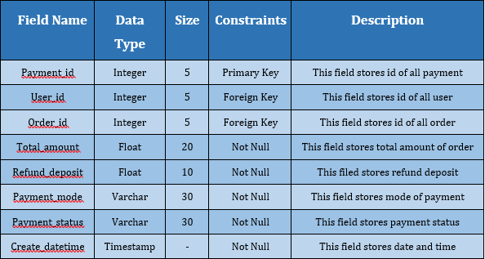
tbl_payment
tbl_payment is the table which stores all the details regarding the payments made by the users on the system. The details regarding payments in this table will be available to have a look. Fields are created for mode of payment in this table.

Slide 45
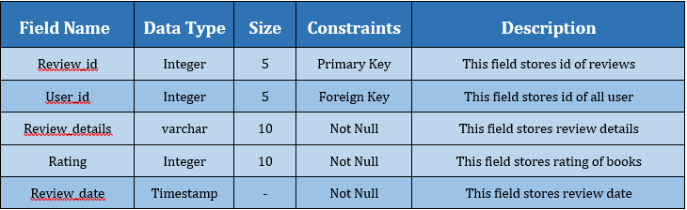
tbl_review
tbl_review is the table which stores all the details regarding the reviews and ratings given by the users on a particular book.The details regarding reviews in this table will be available to have a look. Fields are created for reviews and ratings in this table.

Slide 46
Entity
Relationship
Diagram

Slide 47
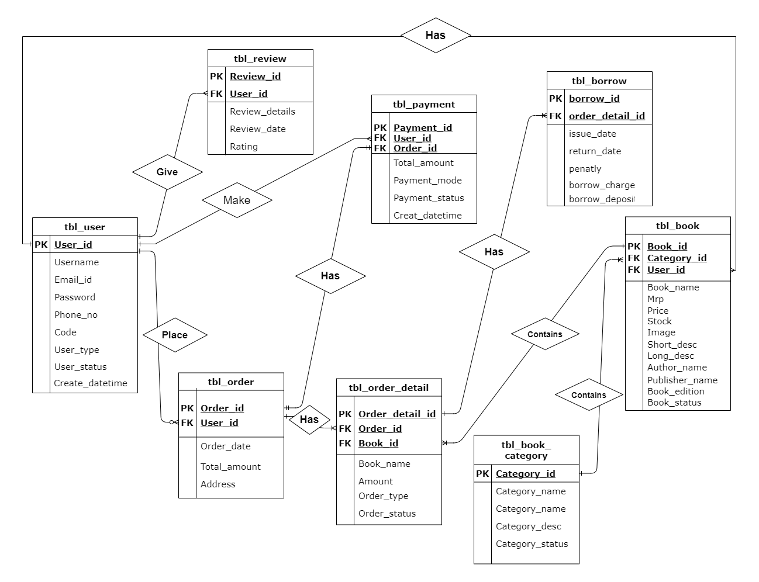

Slide 48
THANK YOU !

